Slide 2
Absence of Copyright
This slideshow contains photos, diagrams, and information, some of which were attained through internet searches of public websites. The author of this presentation does not own the copyright on this information, so this slideshow is for personal use only—not for sale or profit. Please utilize it to seek the Lord and grow in your knowledge of His Word and ways.
Bro Stan’s Revelation Study is available on our church website:
www.faithprinceton.org

Slide 4
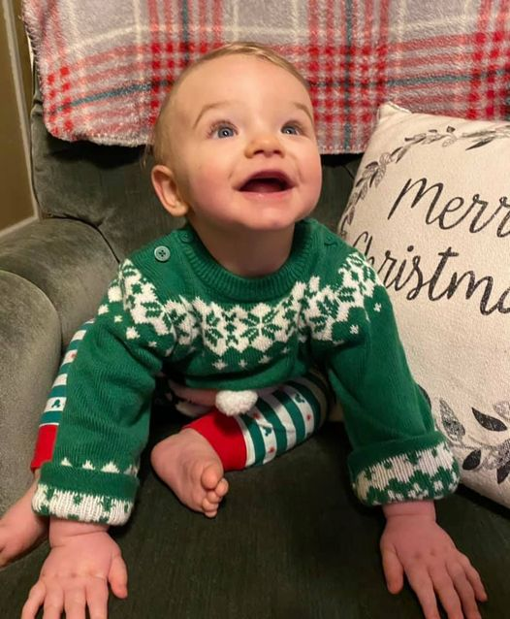
just hangin’ out...
looking forward to Christmas...

Slide 5
Prayer and Announcements
Sundays Facebook Live or In-person:
7:30 Men’s Breakfast
9:15 Small Group Sunday School Classes
10:30 Worship (Facebook or YouTube)
--SPECIAL PRAYER FOR THE NEW YEAR--
Mask in and Mask out...

Slide 7
BEGIN HERE December 30, 2020
Week 30 – Revelation 21
Making All Things New
Notes:
Revelation 21:1-4
1 Then I saw a new heaven and a new earth; for the first heaven and the first earth passed away, and there is no longer any sea. 2 And I saw the holy city, new Jerusalem, coming down out of heaven from God, prepared as a bride adorned for her husband. 3 And I heard a loud voice from the throne, saying, “Behold, the tabernacle of God is among the people, and He will dwell among them, and they shall be His people, and God Himself will be among them, 4 and He will wipe away every tear from their eyes; and there will no longer be any death; there will no longer be any mourning, or crying, or pain; the first things have passed away.”

Slide 8
Revelation 21:5-7 All Things New
5 And He who sits on the throne said, “Behold, I am making all things new.” And He said, “Write, for these words are faithful and true.” 6 Then He said to me, “It is done. I am the Alpha and the Omega, the beginning and the end. I will give water to the one who thirsts from the spring of the water of life, without cost. 7 The one who overcomes will inherit these things, and I will be his God and he will be My son.
Notes:
Behold, I am making all things new.”
Write... these words are faithful and true.” πιστοὶ καὶ ἀληθινοί
In Rev 19:11 Jesus as the Rider on the White Horse is called Πιστὸς καὶ Ἀληθινός
6 “It is done. ➔ Γέγοναν from gínomai – properly, to emerge, become, transitioning from one point (realm, condition) to another. 1096 (gínomai) fundamentally means "become" (becoming, became) so it is not an exact equivalent to the ordinary equative verb "to be" (is, was, will be).... (ginomai) means "to become, and signifies a change of condition, state or place" ... to come into being/manifestation implying motion, movement, or growth" (at 2 Pet 1:4). Thus it is used for God's actions as emerging from eternity and becoming (showing themselves) in time (physical space).
Jesus on the cross: “It is finished.” John 19:30 Τετέλεσται teléō (from 5056 /télos, "consummation, completion") – properly, to complete (consummate), i.e. finish (qualitatively) the necessary process – with the results "rolling-over" to the next level (phase) of consummation. See 5056 (telos).
I am the Alpha and the Omega, the beginning and the end.
I will give water
to the one who thirsts (present participle ➔ the one who is thirsting...) Not just a passing thirst but a continuous one !!
from the spring of the water of life,
without cost. ➔ Babylon sold its products and got rich off its inhabitants !! Jesus offers free satisfaction !!
7 The one who overcomes will inherit these things, and I will be his God and he will be My son.
(again, rewards for faithfulness !!)

Slide 9
Revelation 21:8 The Lake of Fire
8 But for the cowardly, and unbelieving, and abominable, and murderers, and sexually immoral persons, and sorcerers, and idolaters, and all liars, their part will be in the lake that burns with fire and brimstone, which is the second death.”
Notes:
Verse 8 Purpose of this warning to persecuted believers: “Don’t be these things...”
cowardly, and ➔ deilós (an adjective derived from deidō, "fear-driven") – properly, dreadful, describing a person who loses their "moral gumption (fortitude)" that is needed to follow the Lord.
1169 /deilós ("fearful of losses") refers to an excessive fear (dread) of "losing," causing someone to be fainthearted (cowardly) – hence, to fall short in following Christ as Lord.
unbelieving, and ➔ ápistos (from 1 /A "not" and 4103 /pistós, "faithful," see there) – properly, not faithful because unpersuaded, i.e. not convinced (persuaded by God). 571 /ápistos ("faithless, unpersuaded") does not always refer to the unconverted – see Jn 20:27. 571 (ápistos) describes someone who rejects or refuses God's inbirthings of faith
abominable, and ➔ bdelýssō – properly, stink, become foul (abhorrent), detestable as stench; "to strongly detest something on the basis that it is abominable – 'to abhor, to abominate' "
murderers, and ➔ phoneús – a murderer, committing unjustified, intentional homicide.
sexually immoral persons, and ➔ pórnos (from pernaō, "to sell off") – properly, a male prostitute. 4205 (pórnos) is "properly, 'a male prostitute' (so Xen., etc.); in the NT, any fornicator" (Abbott-Smith); i.e. anyone engaging in sexual immorality.
sorcerers, and ➔ phármakos – properly, a sorcerer; used of people using drugs and "religious incantations" to drug people into living by their illusions – like having magical (supernatural) powers to manipulate God into giving them more temporal possessions.
idolaters, and ➔ εἰδωλολάτρης (εἴδωλον, and λάτρις i. e. a hireling, servant, slave), a worshipper of false gods, an idolater, ➔ anyone, even a Christian, participant in any way in the worship of heathen,; especially one who attends their sacrificial feasts and eats of the remains of the offered victims, ; a covetous man, as a worshipper of Mammon,
all liars, ➔ ψευδέσιν
BECAUSE...
their part will be in the lake that burns with fire and brimstone, which is the second death.”

Slide 10
Revelation 21:9-27 The Bride of the Lamb
9 Then one of the seven angels who had the seven bowls, full of the seven last plagues, came and spoke with me, saying, “Come here, I will show you the bride, the wife of the Lamb.”
Notes:
NEW FOCUS: the reward for the faithful...
“the New Jerusalem” v. 9-27
One of the seven angels
Tyndale: We should not overlook the fact that the angel who shows John the bride is introduced in exactly the same terms as the one who showed him the judgment of the whore (17:1). This can scarcely be accidental. John may even mean that it was the same one. He may want us to see, as Barclay suggests, that God’s servants do not select their tasks; God may send them for judgment or for blessing or for both in turn. But they must go where they are sent; they must speak what God tells them to speak. Or John may have in mind that there is but one divine purpose: judgment and grace go together. It issues in the appearance of the bride of the Lamb, but this necessarily involves the judgment of the whore. It is impossible to dwell both in Babylon and the new Jerusalem. To choose Jerusalem is to [Vol 20: Rev, p. 237] renounce Babylon. Judgment on sin is the necessary prelude to the establishment of the city of God.

Slide 11
Revelation 21:9-27 The New Jerusalem
10 And he carried me away in the Spirit to a great and high mountain, and showed me the holy city, Jerusalem, coming down out of heaven from God, 11 having the glory of God. Her brilliance was like a very valuable stone, like a stone of crystal-clear jasper. 12 It had a great and high wall, with twelve gates, and at the gates twelve angels; and names were written on the gates, which are the names of the twelve tribes of the sons of Israel.
Notes:
??? Did the earthly temple OR tabernacle’s gates have the names of the twelve tribes on them?
New Bible Commentary... 11 The city’s appearance is compared to that of a jasper, and so its glory is like that of the Creator (see 4:3).
12-13 The great, high wall serves the dual purpose of keeping out those who have no part in the city (21:27; 22:14-15) and of providing eternal security for those inside. Its twelve gates are inscribed with the names of the twelve tribes of Israel, just as the wall’s twelve foundations have on them the names of the twelve apostles of the Lamb. Therein the unity of the people of the old and new covenants is seen; together they form ‘the Israel of God’, expanded to embrace all nations in Christ.
the gates bear the names of the twelve tribes of Israel (cf. Ezek. 48:31–34).

Slide 12
Revelation 21:9-27 The New Jerusalem
13 There were three gates on the east, three gates on the north, three gates on the south, and three gates on the west. 14 And the wall of the city had twelve foundation stones, and on them were the twelve names of the twelve apostles of the Lamb.
Notes:
The tribes camped on the four sides of the tabernacle (see Numbers? _________________ ???
Ezekiel 48:30-35
³⁰ “Now these are the exits of the city: on the north side, 4,500 cubits by measurement, ³¹ shall be the gates of the city, named for the tribes of Israel, three gates toward the north: the gate of Reuben, one; the gate of Judah, one; and the gate of Levi, one. ³² On the east side, 4,500 cubits, shall be three gates: the gate of Joseph, one; the gate of Benjamin, one; and the gate of Dan, one. ³³ On the south side, 4,500 cubits by measurement, shall be three gates: the gate of Simeon, one; the gate of Issachar, one; and the gate of Zebulun, one. ³⁴ On the west side, 4,500 cubits, shall be three gates: the gate of Gad, one; the gate of Asher, one; and the gate of Naphtali, one. ³⁵ The city shall be eighteen thousand cubits all around; and the name of the city from that day shall be, ‘The Lord is there.’”
??? INTERESTING THOUGHT??? Aren’t walls usually built on foundations first, but in this construction the apostles are foundational and the twelve tribes are gates... ???

Slide 13
Revelation 21:9-27 The New Jerusalem
15 The one who spoke with me had a gold measuring rod to measure the city, its gates, and its wall. 16 The city is laid out as a square, and its length is as great as the width; and he measured the city with the rod, twelve thousand stadia; its length, width, and height are equal. 17 And he measured its wall, 144 cubits, by human measurements, which are also angelic measurements.
Notes:
Measuring the city....
Gold measuring rod???
??? Built as a cube??? Length, width, and height are equal
1Kings 6:20 The inner sanctuary (Holy of Holies) was twenty cubits in length, twenty cubits in width, and twenty cubits in height, and he overlaid it with pure gold. He also overlaid the altar with cedar.
Tyndale: 15. The angel … had a measuring rod of gold. The purpose (hina) was to measure the city, its gates, and its wall. Measuring evidently signifies security and protection (in 11:2 the outer court which was given over to the Gentiles was not measured).
Measurement Numbers:
12,000 stadia = 1500 miles on each side (from Dallas to New York City [1,557 miles] or Los Angeles [1,436 miles]) or Houston to Winnipeg, Canada [1,535 miles]
Tyndale: A city of this size is too large for the imagination to take in. John is certainly conveying the idea of splendour. And, more importantly, that of room for all.
144 cubits = 216 ft.? ??? Height? Or Thickness of the Wall? ???
Comparison: Great Wall of China = 13,170 miles long, 25.6 feet high, 16 feet wide
Tyndale: If we are trying to form a mental picture of all this we are in some trouble. The measurement will surely refer either to the wall’s height or its thickness. If the former, it is curiously low for a city 12,000 stadia high, and we have been informed that the wall was ‘great and high’ (v. 12). If the latter, it needs no builder to discern that a wall 1,500 miles high needs a broader base than 72 yards. Clearly the number is symbolical. Swete takes the 144 cubits to be the wall height and sees it as underlining the point that ‘the walls of the City are not for defence – for there is no enemy at large any more – but serve for delimitation’.
Human measurements = angelic measurements???
What would that look like???

Slide 14
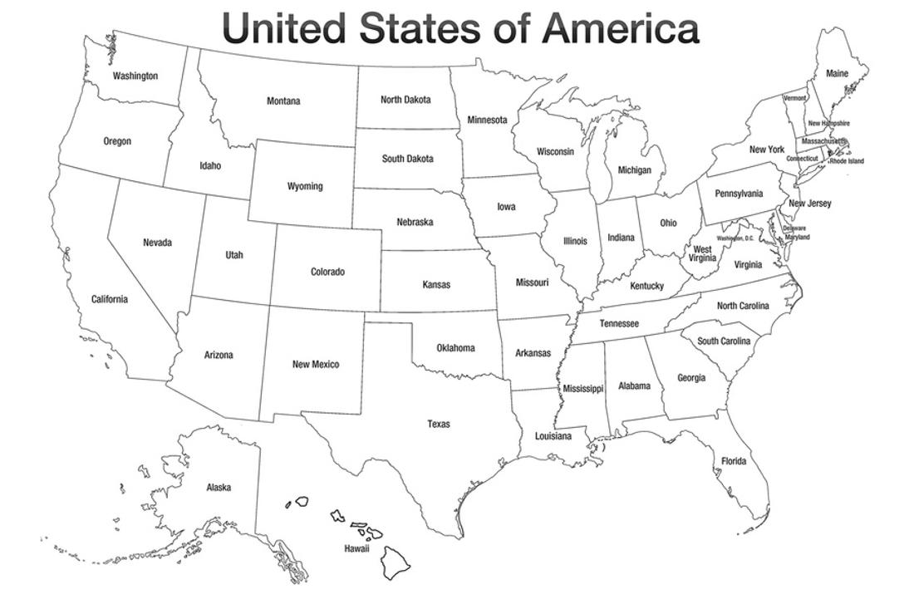
Approximate size of a 1,500 sq mile city

Slide 15
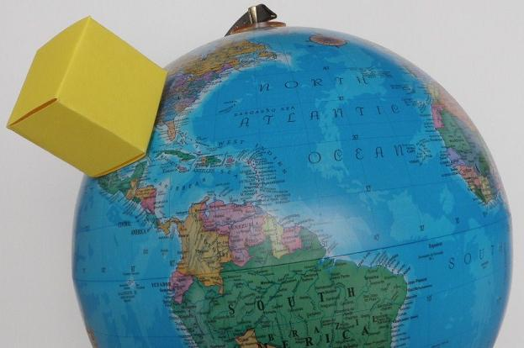
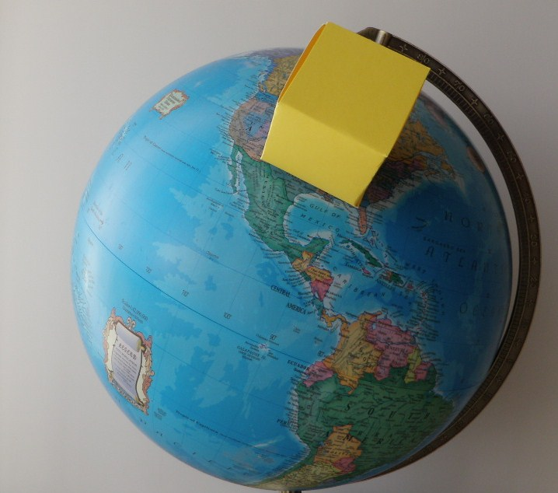
To give you a better idea just how big New Jerusalem is, here are some representations of what it would look like on Earth if the city is shaped like a cube.
Over North America:
Notes:
http://tourofheaven.com/eternal/new-jerusalem/size.aspx
Size of New Jerusalem
How large is the city? That varies slightly depending on the version of the Bible. The ESV and NIV versions say it is 12,000 stadia in length and width(Rev. 21:16), where a stadia is 607 feet. This translates to 1,400 miles, which is what the NLT Bible says. However, the KJV and other versions say 12,000 furlongs, which translates to 1,500 miles.
Regardless of whether the city is 1,400 miles or 1,500 miles in length and width, it is shaped like a square at the base. This means New Jerusalem is larger than India with nearly 2 million square miles. These measurements are meant to be literal since they are described as man's measurements(Rev. 21:17).
Even more astounding than the size at the base is the height that is also at least 1,400 miles(Rev. 21:16). This goes well beyond Earth's atmosphere and into space. If a building in the city is this high and has a generous 12 feet per story, the building would be over 600,000 stories!
To give you a better idea just how big New Jerusalem is, here are some representations of what it would look like on Earth if the city is shaped like a cube.
Over North America:

Slide 16
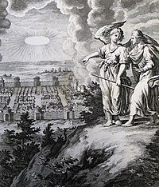
Why do we need to know these measurements?
Notes:
Why do we need to know these measurements?
Displays grandeur
Room for all
Temple served as shadow of reality ➔ we are a kingdom of priests to represent Christ in His universe
Demonstrates reality (even if numbers are symbolic, something you can measure is real...)

Slide 17
Revelation 21:9-27 The New Jerusalem
18 The material of the wall was jasper; and the city was pure gold, like clear glass. 19 The foundation stones of the city wall were decorated with every kind of precious stone. The first foundation stone was jasper; the second, sapphire; the third, chalcedony; the fourth, emerald; 20 the fifth, sardonyx; the sixth, sardius; the seventh, chrysolite; the eighth, beryl; the ninth, topaz; the tenth, chrysoprase; the eleventh, jacinth; the twelfth, amethyst.
Notes:
Pure gold like clear glass:
Very pure
Very costly and hard to make
Very rare
Very brilliant, shiny
The list of jewels that decorate the foundations is startling. Despite some uncertainties of translation they appear to be identical with the jewels inscribed with the names of the twelve tribes on the high priest’s breastplate (Ex. 28:15-21).
¹⁷ “You shall mount on it four rows of stones; the first row shall be a row of ruby, topaz and emerald; ¹⁸ and the second row a turquoise, a sapphire and a diamond; ¹⁹ and the third row a jacinth, an agate and an amethyst; ²⁰ and the fourth row a beryl and an onyx and a jasper; they shall be ¹set in gold filigree. ²¹ “The stones shall be according to the names of the sons of Israel: twelve, according to their names; they shall be like the engravings of a seal, each ªaccording to his name for the twelve tribes
Foundation Stones:
jasper;
sapphire;,
chalcedony;,
emerald;
sardonyx;
sardius;
chrysolite;,
beryl;
topaz;
chrysoprase;
jacinth;
amethyst.

Slide 18
Revelation 21:9-27 The New Jerusalem
21 And the twelve gates were twelve pearls; each one of the gates was a single pearl. And the street of the city was pure gold, like transparent glass.
Notes:
The Pearly Gates and streets of Gold!!!
Not just one, but twelve single pearls ! What sized oysters are in heaven???

Slide 19
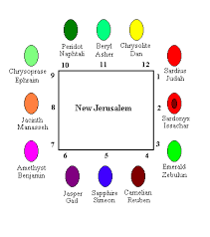

Slide 20
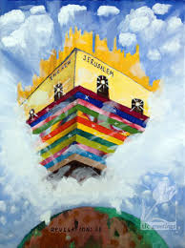
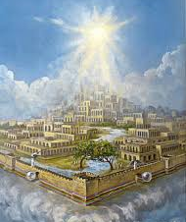
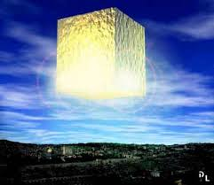
Notes:
Newport (305) “God takes Israel and the church through the stages of the earthly Jerusalem, the heavenly Jerusalem, and the new Jerusalem in order to teach them that humanity’s dream of a holy city is not a delusion. Rather, the holy city is the goal toward which redeemed people, salvation history, and the whole creation move.”

